Slide 1
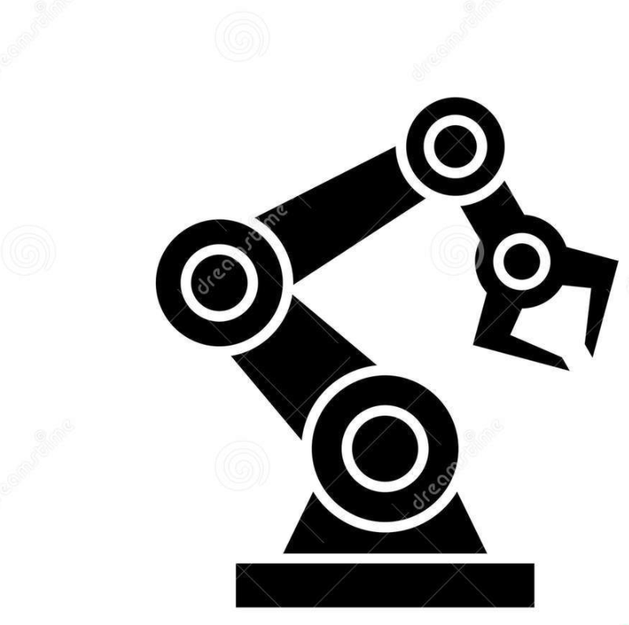

MAE 547 Modelling and Control of Robot (Fall 2021) Dr. Hyungae Lee
Final Project #2
Simulation and Manipulation of a RPP Robot
using Matlab
Done By:
Aravind Adhith Pandian Saravanakumaran (1222209391)
Monish Dev Sudhakhar (1220859588)
Gowtham Dakshnamoorthy (1222598585)

Slide 2

CONTENTS
Problem Statement
Inverse/forward kinematics
Trajectory Planning
DH Table
Inverse kinematics of the mechanism
Working / Program Flow
Workspace of the RPP robot
Motion Simulation
Velocity / Acceleration Profile
Results/Observation
Application/Future Scope
Contribution

Slide 3
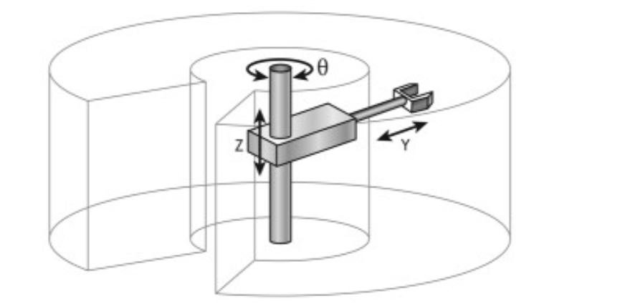
Problem Statement
The objective of the project is to employ trajectory calculation and workspace plotting of a RPP robot using robotic toolbox in MATLAB.
An RPP robot consists of a cylindrical base with two prismatic joints orthogonal to each other where the end effector could be manipulated within a cylindrical workspace.
To elucidate further, using inverse kinematics concept the joint parameters are being calculated with respect to the end effector position.
Computation of Joint Space Trajectory in accordance with end effector position.
Simulation of End effector motion between initial and next coordinates in the workspace and Velocity and acceleration profiles are plotted as a function of time

Slide 4
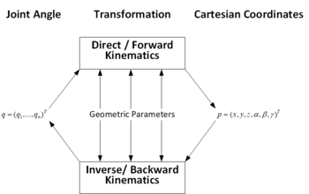
Forward and Inverse Kinematics
Forward kinematics refers to the use of the kinematic equations of a robot to compute the position of the end-effector from specified values for the joint parameters
The reverse process that computes the joint parameters that achieve a specified position of the end-effector is known as inverse kinematics.

Slide 5
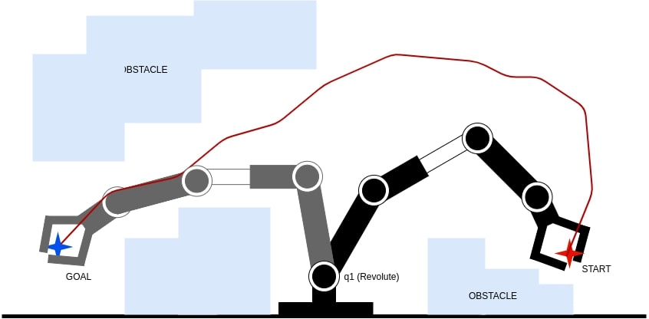
Trajectory Planning
Referred to as motion planning and erroneously as path planning.
It is distinct from path planning and is parametrized by time.
It encompasses path planning in addition to planning how to move based on velocity, time, and kinematics.
Gives a path from a starting configuration S to a goal configuration G avoiding collisions in a 2D or 3D space.
Problem Constraints
Holonomic / Kinematic Redundancy is the relationship between the controllable degrees of freedom of the robot and the total degrees of freedom of the robot
i.e. DOF_{CONTROLLABLE} ≤ DOF_{TOTAL}

Slide 6
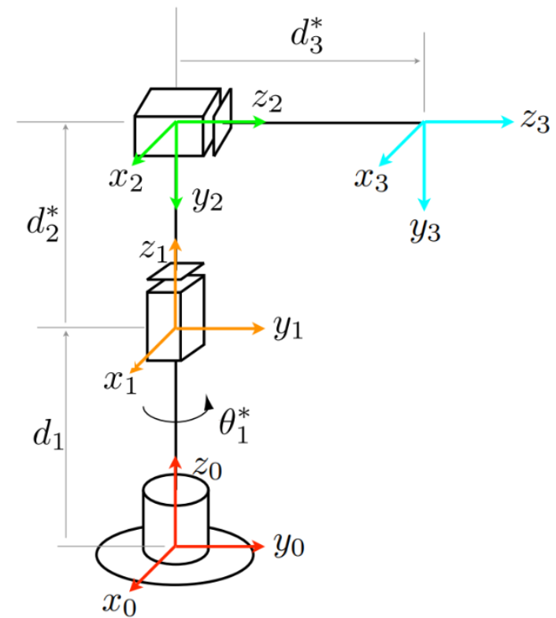
DH Table for the Mechanism & Transformation Matrix
Links | Theta(θ) | d | a | Alpha(α)
1 | θ1 | 5 | 0 | 0
2 | 0 | d2 | 0 | -π/2
3 | 0 | d3 | 0 | 0

Slide 7
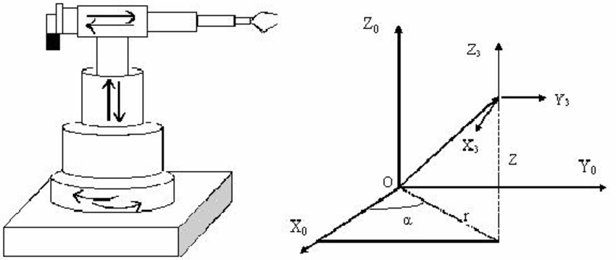
Inverse Kinematics of the Mechanism
From the final transformation matrix of the RPP robot, the end effector positions could be derived.
P_{X} = -Sin Q₁ * d₃
P_{Y} = Cos Q₁ * d₃
P_{Z} = d₁ + d₂
The joint parameters are Q₁, d₂ and d₃
which are function of end effector values
Q₁ = -Tan⁻¹ (P_{X}/P_{Y})
d₂ = P_{Z} – d₁ (Known Value)
d₃ = [(P_{X})² + (P_{Y})²]^{1/2}

Slide 8
Working of the Program
Firstly, the robot is being defined by its link properties and the joint configuration.
And then the DH table is being computed for the given robot definition.
Then the transformation matrix is being formulated as per the robot configuration.
Then the user is allowed to enter the desired final and initial position of the end effector
By means of the inverse kinematics the joint parameters are being calculated.
Then the kinematic singularity is being calculated for the given end effector position, if none found then it is further proceeded
As no kinematic singularity is being detected, then the movement of end effector from start point to the end point is being shown in the workspace.
On the other hand, the trajectory is being computed for the given start and end points by means of jtraj command.
In addition to that the corresponding workspace is being plotted for the given end effector position.
So, for multiple configurations, the outputs could be derived for a RPP robot.
To show the effectiveness of the program output, 3 different end effector locations will be tried.

Slide 9
Program Flow
Get Start and Goal cartesian coordinates from the user
Map those coordinates to EE pose/axis
Use inverse kinematics to get Start and Goal joint configuration
Use mstraj to get various joint configuration between start and goal config
If joint limit exceeds, quit the program
Robot Animation: using robot.plot
Drawing Trajectory: Use fwd kinematics to get x,y,z for each joint config
Use plot3 to draw points
Display the coordinates (start, goal)
Calculating time to each goal using cputime
Ask again for another goal position (Homing in start ONLY)

Slide 10
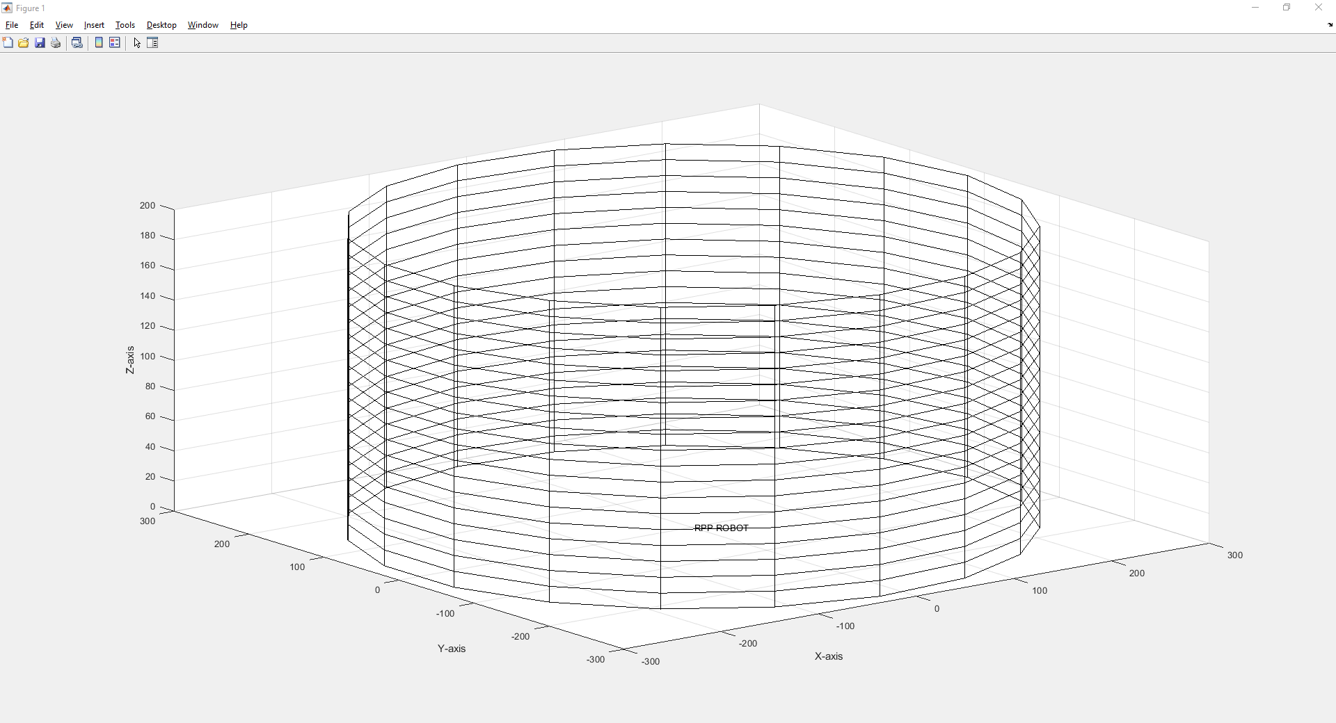
Workspace of RPP robot
General workspace of RPP robot which is being done.

Slide 11
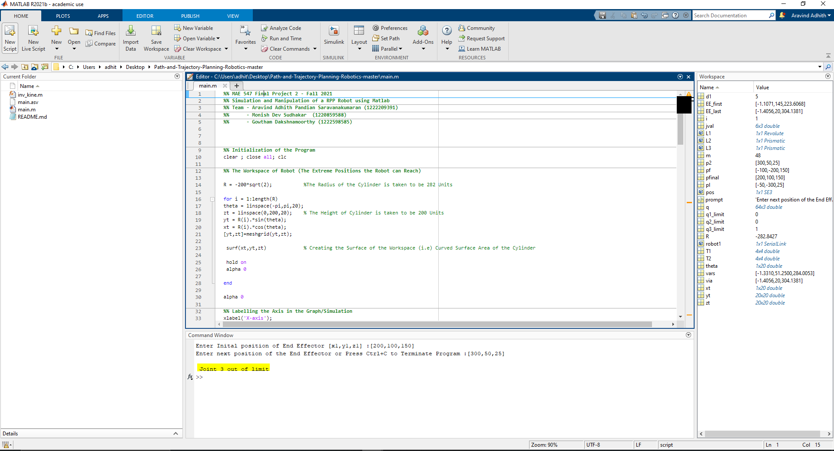
Case 1:- (Out of Workspace Case)
In this case the start or end point of the end effector positions are being fed as inputs such as it exceeds the limit of the workspace of a RPP robot, the program terminates.

Slide 12
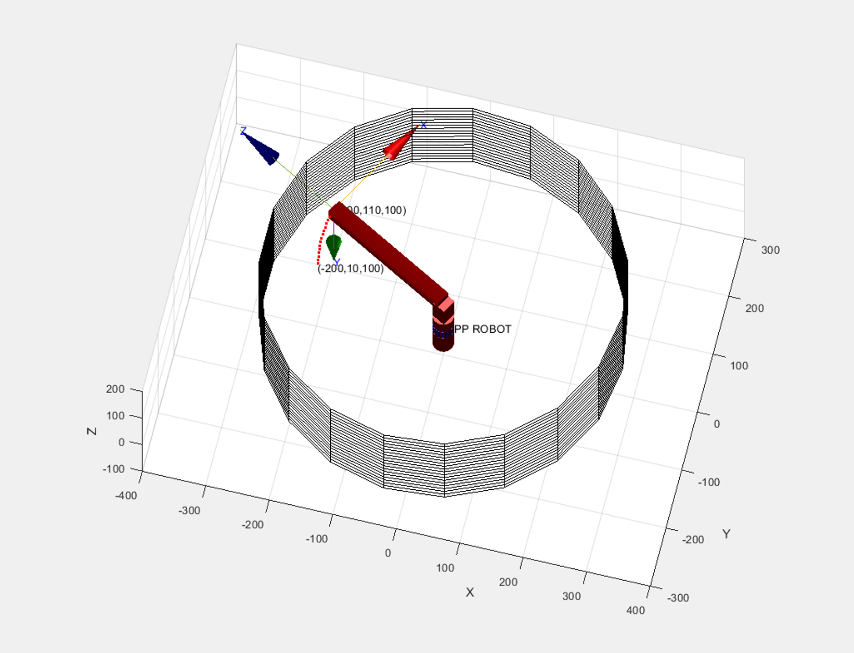
Case 2:-Small workspace area
i.e.; The travel of the end effector position is small.
Initial Coordinate : [-200,10,100]
Final Coordinate : [-200,110,100]

Slide 13
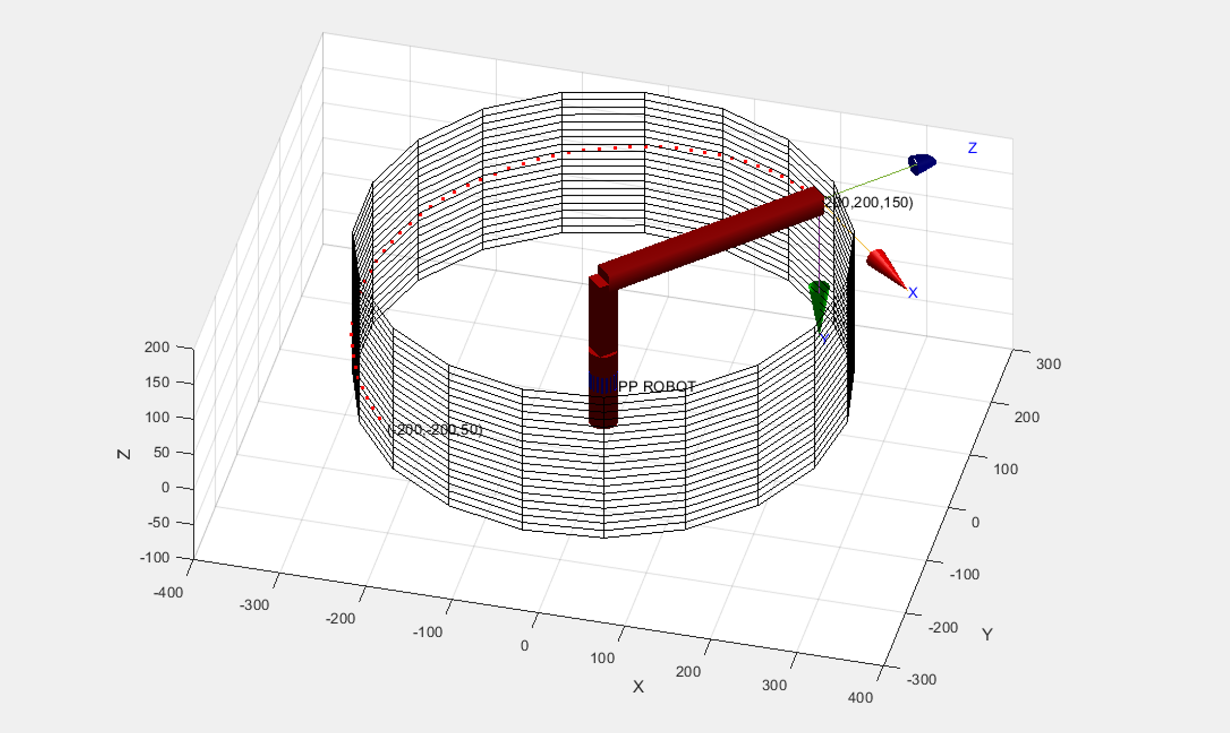
Case :-Large workspace area
i.e.; The travel of the end effector is large which is evident from the below result
Initial Coordinate : [-200,-200,50]
Final Coordinate : [200,200,150]

Slide 14
Motion Simulation

Slide 15
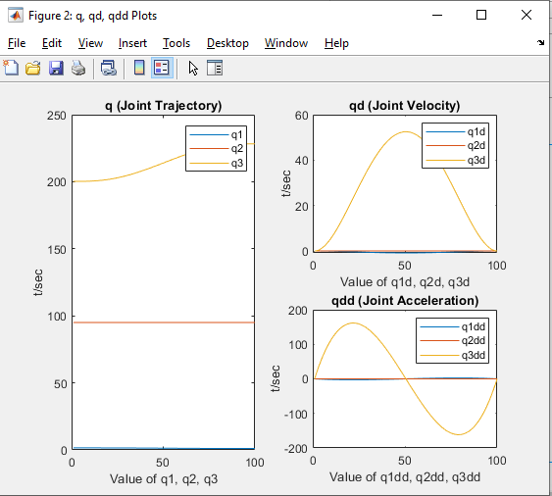
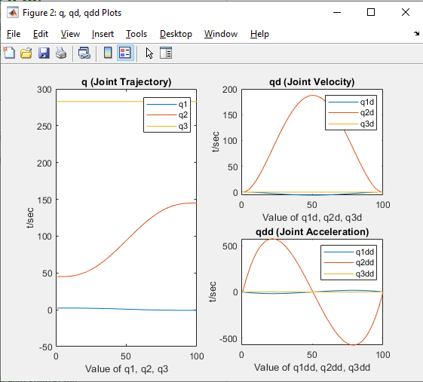
Joint Variables Trajectory, Velocity and Acceleration Graphs
Small Movement
Large Movement

Slide 16

Results / Observation
The concepts being used are the outcomes of course MAE 547 and it has been implemented intuitively during each study.
Hence , the robot is simulated for the given trajectory and then workspace is being plotted in 3 Cases.
The joint velocity profiles are plotted as a function of time.
The joint acceleration profile is plotted as a function of time.
The existing simulation can be extended to the real world system with complicated assembly and structures involving high DOF.

Slide 17
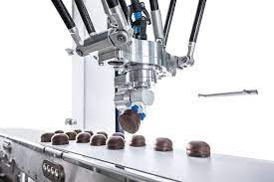
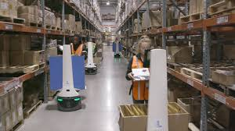

Applications / Future Scope
RPP is used for the major applications like/as:
Pick and Place robot
Warehouse robot
Future research is possible by extending this study :
By using modern control techniques
By using advanced techniques like Computer Vision, Machine Learning etc

Slide 18

Contribution:-
We worked on project together right from the initial state. This is done with the complete coordination of 3 of us..
Topic Selection, Robot definition and DH Table calculation , Code snippet - Aravind
Inverse /Forward kinematics , Code Snippet (Contd) , Presentation - Monish
Trajectory planning and end Effector manipulation , Presentation (Cont)- Gowtham
Name | Contribution (in %)
Aravind Adith Panidan Saravanakumaran | 33.33
Monish Dev Sudhakhar | 33.33
Gowtham Dhakshnamoorthy | 33.33
Total | 100

